Slide 1

ARDUINO SUMMER CAMP
SOUTH TEXAS COLLEGE

Slide 2
NICHOLAS HINOJOSA
South Texas College Computer Science Instructor
Bachelor’s in CIT
Masters in IT from UTPA
Certifications from Cisco (CCNA, CCENT)
Certification from SANS (GSEC)
Certification from CompTIA (Security+)
Certificate from Google (Google IT Support Pro)
Programming I, II, III, C Programming
Survey of Programming, Advanced Web Design
Advanced Networking, Database Management
Internet/Internet Server Integration
Fundamentals of Information Security

Slide 3
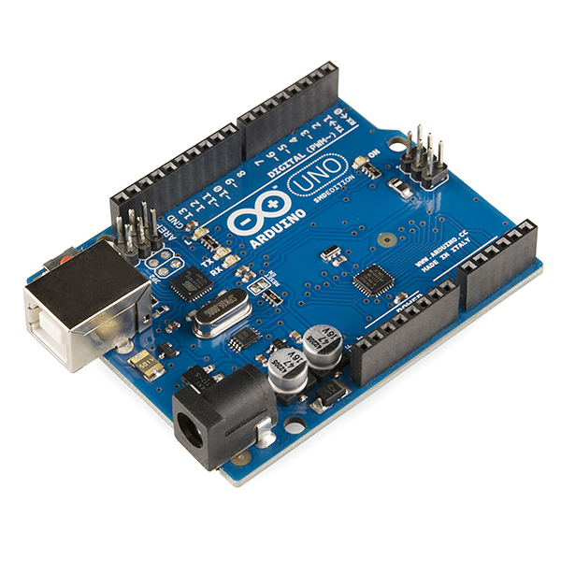
ABOUT SUMMER CAMP
Physically programmable microcontroller
Create electronic projects with hardware and software
Connects with input and output devices, such as ultrasonic distance, LEDs, motors, LCD screens, push buttons, temp sensors, phototransistors, etc.

Slide 4
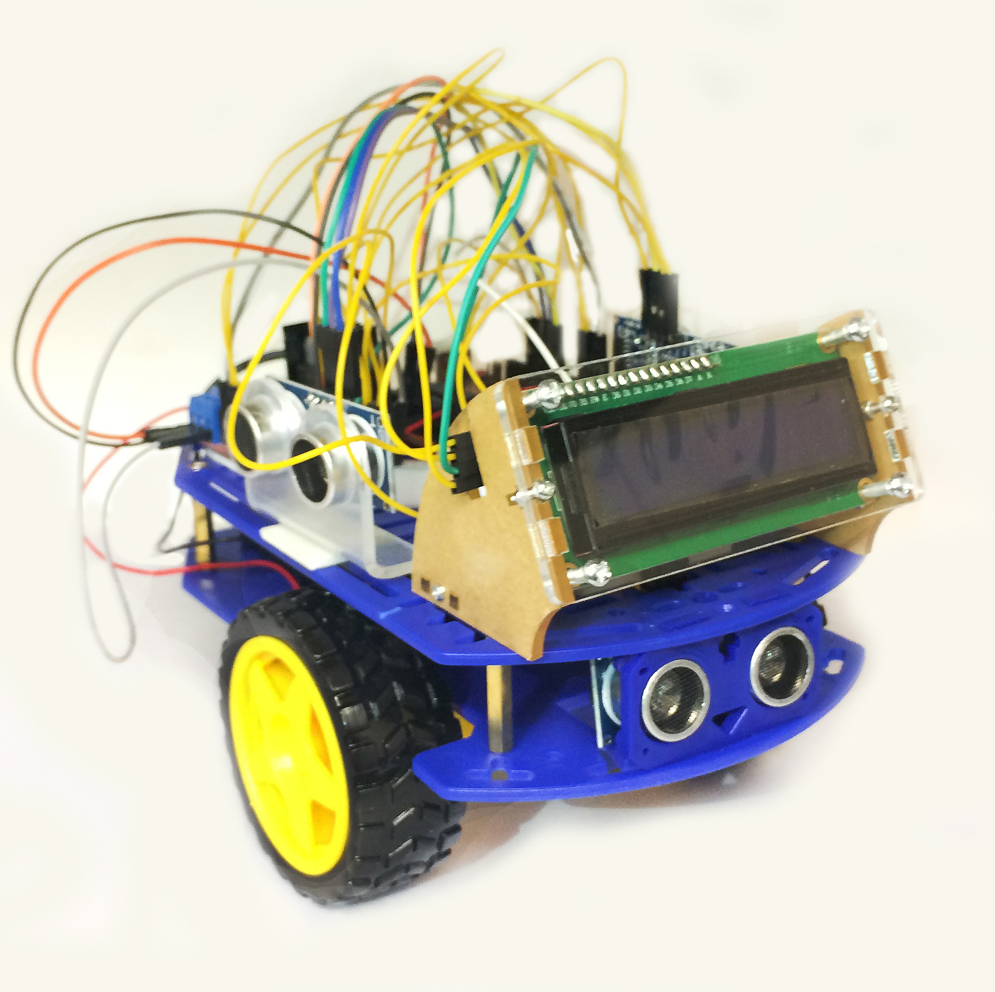
What you will need
Arduino Smart Car Kit (Mailed)
Laptop or Desktop
Scissors
Arduino IDE (web or installed)
Setup Account with TinkerCad
https://github.com/nhinojosa/SummerCamp2021

